Slide 1
Hack the Future:
A Gen AI Sprint Powered by Data

Slide 2

Guidelines
The template should consist of the following and it is mandated to be used by your team for submitting your innovative ideas/solutions. Follow file naming format: Team name_Idea Name.pptx

Slide 3



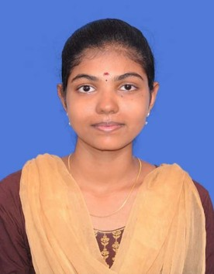

Hack the Future: A Gen AI Sprint Powered by Data
Data and AI Week
Team details
TEAM NAME: CareNetics
Aruna M
Gomathi K.S
Photo

Slide 4
Entry Submission Summary
Idea Title (Provide a concise and impactful title for your idea.) | Connected Care: Transforming Elderly Support with Multi-Agent AI Systems
Team Name | CareNetics
Problem Statement | Empowering Elderly Care with multi agent AI system
Proposed Solution | Our solution is a collaborative multi-agent AI system designed to support independent elderly living by offering real-time health monitoring, behavioral analysis, emergency alerts, and personalized reminders, while fostering continuous engagement between caregivers, healthcare providers, and family members for holistic and responsive care

Slide 5
Problem Statement
With the global elderly population rapidly increasing, ensuring the safety, health, and emotional well-being of seniors living independently has become a pressing challenge. Many face risks such as medical emergencies, missed medications, cognitive decline, or loneliness—often without timely support or supervision.
Current care systems are often reactive, fragmented, and lack real-time collaboration between family members, caregivers, and healthcare providers. Moreover, most technological solutions are either too complex for seniors or fail to integrate the full spectrum of care needs.
There is a critical need for an intelligent, collaborative, and easy-to-use system that empowers elderly individuals to live independently, while ensuring peace of mind for their support networks through proactive monitoring, timely alerts, routine management, and social engagement.

Slide 6
Proposed Solution Overview
We propose the development of a Multi-Agent AI System designed to enhance elderly care by delivering real-time, intelligent support to individuals living independently. This system leverages a network of specialized AI agents, each responsible for a specific aspect of care—such as health monitoring, routine reminders, behavior analysis, emergency detection, and social engagement.
Key features include:
Real-time Health Monitoring: Tracks vital signs and activity using wearable or ambient sensors, detecting anomalies such as falls or unusual behavior.
Smart Alerts & Emergency Response: Immediately notifies caregivers, healthcare providers, or family in case of critical events.
Personalized Reminders: Helps manage daily tasks like medication intake, appointments, hydration, and physical activity.
Social & Emotional Support: Promotes engagement through virtual interactions, companionship agents, and scheduled check-ins to reduce isolation.
Collaborative Care Network: Seamlessly connects family members, caregivers, and doctors through a shared dashboard, ensuring coordinated care.
By combining autonomy, intelligence, and connectivity, this multi-agent system empowers elderly individuals to live safely and confidently—while keeping their support network informed and involved

Slide 7
Technologies Used
SPADE (Python) – For building intelligent multi-agent systems
IoT Devices & Wearables – Real-time health monitoring
OpenCV & YOLOv8 – Fall and behavior detection via vision
Text-to-Speech & Voice Assistants – Reminder delivery (Google TTS, Alexa SDK)
Firebase – Emergency alerts and push notifications
MongoDB / Firebase – Secure data storage
FastAPI / Node.js – Backend services & APIs
React / Angular – Caregiver dashboard interface
Docker & Kubernetes – Deployment and scalability in the cloud

Slide 8
Agents' interaction design
Elderly Care Multi-Agent System
├── Health Monitoring Agent
│ ├── Inputs: Vital signs, health metrics
│ ├── Outputs: Health alerts, status reports
│ └── Interactions:
│ ├── → Safety Agent: Shares health context
│ └── → Reminder Agent: Triggers medication alerts
├── Safety Monitoring Agent
│ ├── Inputs: Movement data, location, activity
│ ├── Outputs: Fall alerts, inactivity warnings
│ └── Interactions:
│ ├── → Health Agent: Activity context
│ └── → Emergency Services: Critical alerts
└── Reminder Agent
├── Inputs: Schedule, medications, appointments
├── Outputs: Voice reminders, notifications
└── Interactions:
├── → Health Agent: Medication compliance
└── → Caregiver: Schedule updates

Slide 9
Code structure
elderly_care_system/
├── agents/
│ ├── __init__.py
│ ├── health_agent.py # Health monitoring and alerts
│ ├── safety_agent.py # Fall detection and activity monitoring
│ └── reminder_agent.py # Medication and appointment reminders
├── database/
│ ├── __init__.py
│ ├── models.py # Database models for Elder, Health, Activity
│ └── elderly_care.db # SQLite database file
├── ui/
│ ├── __init__.py
│ ├── dashboard.py # Main dashboard interface
│ ├── health_view.py # Health monitoring view
│ ├── activity_view.py # Activity tracking view
│ └── reminder_view.py # Reminders management view
├── utils/
│ ├── __init__.py
│ ├── notifications.py # Alert and notification system
│ └── data_processor.py # Data processing utilities
├── static/
│ ├── css/
│ │ └── style.css # Custom styling
│ └── images/
│ └── icons/ # UI icons and images
├── requirements.txt # Project dependencies
├── config.py # Configuration settings
└── app.py # Main application entry point

Slide 10
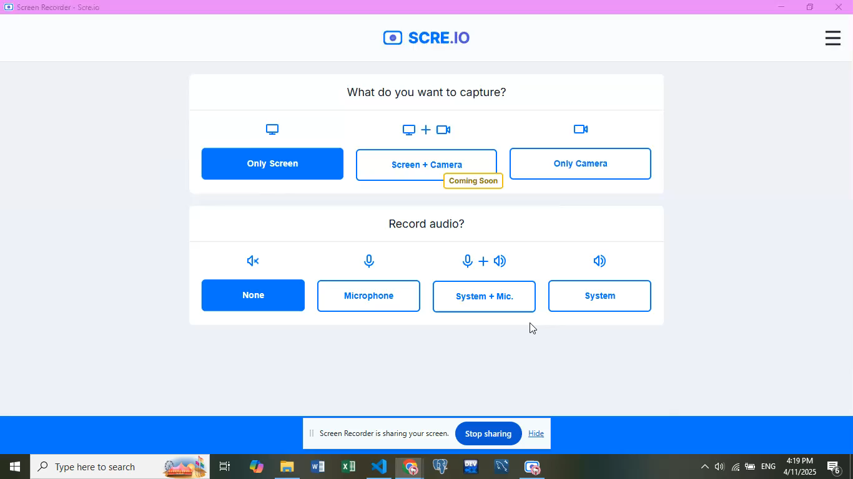
Demo video

Slide 11
Conclusion
Our multi-agent AI system offers a comprehensive, real-time support network for elderly individuals living independently. By integrating intelligent agents for health monitoring, safety detection, daily reminders, and communication, the system ensures:
Improved health outcomes through continuous tracking and timely alerts
Enhanced safety via smart behavior detection and emergency response
Increased independence with personalized reminders and voice interactions
Stronger caregiver collaboration through centralized dashboards and notifications
This solution directly addresses the problem statement by combining AI, IoT, and communication tools into a scalable, deployable system—delivering peace of mind to families and a better quality of life for the elderly.

Slide 12
References/Other details
https://docs.streamlit.io/
https://fastapi.tiangolo.com/
https://docs.sqlalchemy.org/
https://docs.sqlalchemy.org/
https://scikit-learn.org/

Slide 13
Thank You

